Slide 1

E-commerce Platforms
Group 08:
Chau Kim Toa - 18110056
Bui Thi Thao Thao – 19110125
Instructor: Nguyen Thien Bao

Slide 2
Contents
Introduction
02
Shopify Demo
04
Big Commerce Demo
Definition, feature and reason to use an eCommerce platform
Demo for Shopify
Demo for Big Commerce
01
03
Shopify
Big Commerce
05
Definition and function
Definition and function
Group 08

Slide 3


Chapter 1: Introduction
01
Definition
Definition of an eCommerce platform
02
Why should you use an eCommerce platform?
Why should we use eCommerce platform?
What are the convenients it brings?
03
Features of an eCommerce Platform
What features does an eCommerce Platform have?
04
Example for eCommerce Platforms
Example for some most used and good rated eCommerce Platforms
Group 08
Group 08

Slide 4


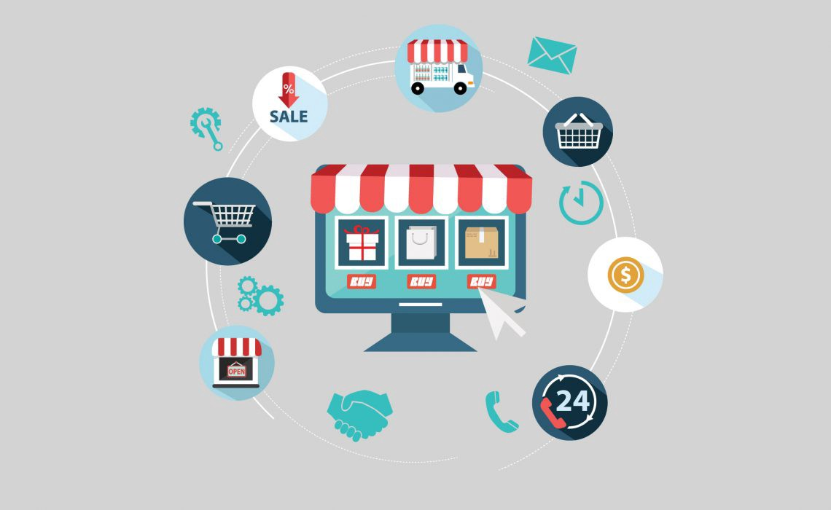
01. Definition of eCommerce Platform
What is
an eCommerce Platform?
An eCommerce platform is an end-to-end software solution that allows online retailers to manage their business.
This type of service encompasses eCommerce website builders, accounting and inventory management systems, as well as customer service infrastructure.
Chapter 01

Slide 5




02.Why should you use an eCommerce platform?
Cost less than creating software from scratch
Software solutions allow you to manage multiples tasks
Easy for customers to use
Chapter 01

Slide 6

03. Definition of eCommerce Platform
Security
Payment processing
Design options
Support
Interface
Promotion opportunities
Store management system
Data consolidation
Chapter 01

Slide 7





04. Example for eCommerce Platforms
Wix
WooCommerce
Shopify
BigCommerce
Shift4Shop
Chapter 01

Slide 8
Chapter 02: Shopify
Advantage of Shopify
Definition
Benefits when using Shopify
What is Shopify?
Shopify
Disadvantage of Shopify
Problems with Shopify
Group 08

Slide 9




01. Definition of Shopify
”
Shopify is a complete commerce platform that lets you start, grow, and manage a business.
”
”
The subscription-based software allows anyone to set up an online store and sell their products.
”
”
Shopify store owners can also sell in physical locations using Shopify POS, our point-of-sale app and accompanying hardware.
”
Chapter 02

Slide 10







02. Advantage of Shopify
Quick & easy to set up & use
Mobile ready
Abandoned cart recovery
No tech worries
Customisable
Own payment gateway
Secure & reliable
There’s an app for that
24/7 customer support
SEO & Marketing tools
Chapter 02

Slide 11

03. Disadvantage of Shopify
Pay Monthly For Every Little Thing
01
02
Less Customizability
Cons
Service lock-in
04
03
Content Management
Chapter 02

Slide 12
Chapter 03: BigCommerce
Features of BigCommerce Platform
BigCommerce Platform have what to offer? SEO Tools?
02
Pros & Cons of
BigCommerce
Definition
What is BigCommerce?
What are the benefit and disadvantage ?
03
01
Payment BigCommerce
What payments do BigCommerce support?
04
Group 08

Slide 13


01. Definition of BigCommerce
What is
BigCommerce Platform?
BigCommerce is a hosted e-commerce platform that allows business owners to set up an online store and sell their products on the web.
Chapter 03

Slide 14







02. Features of BigCommerce Platform
Integrating drop shipping and warehouse
Features:
Supports many different currencies and payment gateways
BigCommerce has a variety of interface and design options.
It provides users with up to 100 themes including paid and free with many different choices.
The system of inventory management, return, shipping, report
The shopping cart is considered safe
There are many tools to promote products and services such as Pinterest, eBay, Facebook ...
Designed with many SEO tools to help your website quickly rank in search results so that traffic to your store increases rapidly.
Chapter 03

Slide 15

03. Advantages and disadvantages of BigCommerce
ADVANTAGES | DISADVANTAGES
There are many impressive features. | You have to pay quite a lot to have abandoned cart functionality.
It’s simple to sell products in different currencies at the same time. | Annual online sales have limits. You’ll need to upgrade to a costlier monthly plan if you surpass those limits.
All of their plans have third-party shipping calculations that are in real-time. | There isn’t much originality in many of the free themes. Some of them resemble each other too much.
BigCommerce doesn’t charge any transaction fees, no matter what payment gateways you use. | The page builder features have some definite room for improvement (recently they have made updates that make things much easier).
All plans also have very effective reporting resources. | Free templates aren’t as simple to change as they could be.
It’s easy to create custom fields.
Clients can upload files while they’re placing orders.
Built-in product review feature.
You can create all kinds of unique pages with their intuitive drag and drop page builder.
BigCommerce has helpful built-in search engine optimization functions.
The ‘abandoned cart saver’ tool is more comprehensive than the similar offering from competitors.
All plans let you have as many staff accounts as you want.
People with multiple product variants have more flexibility.
Chapter 03

Slide 16

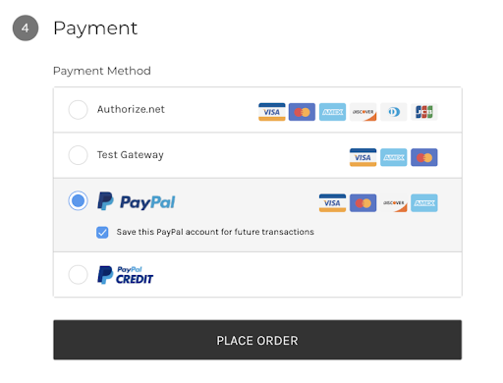
04. Payments of BigCommerce Platform
BigCommerce has more than 60 payment gateways giving you many different options and good handling of foreign currencies.
Moreover, this platform allows you to create promotions and discounts to attract customers.
Chapter 03

Slide 17
Shopify
Or
BigCommerce
√ Which platform should you use?
Group 08

Slide 18

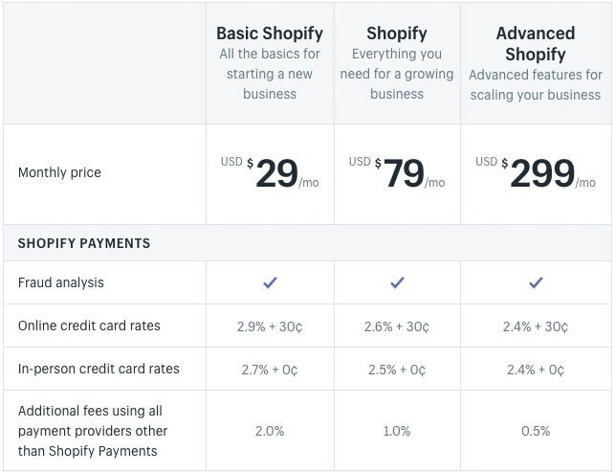
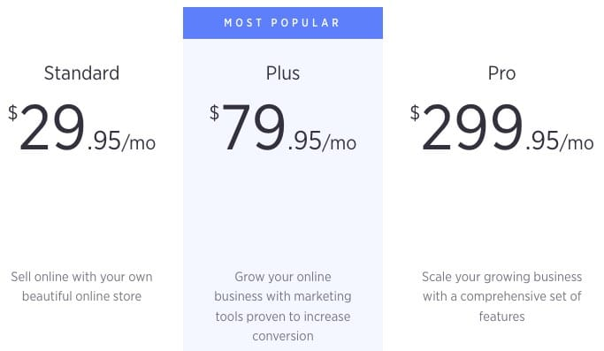
01. Shopify pricing vs BigCommerce pricing
Shopify Offers
BigCommerce Offers
I

Slide 19
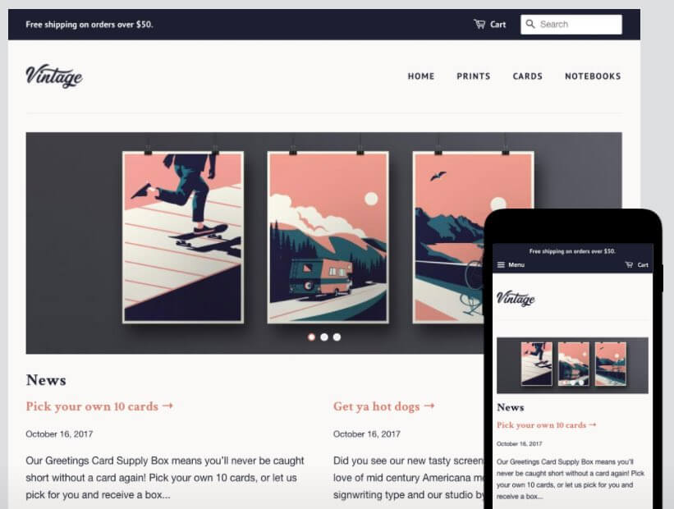
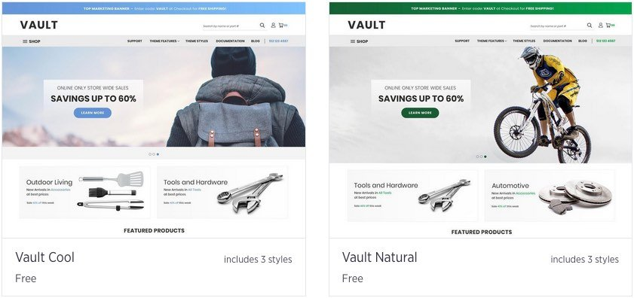
02. Templates
Shopify gives you 7 free themes. These free themes are mostly different. Shopify has about 70 paid-for templates, and they cost between $150 – $350. | Bigcommerce gives you 10 free themes. These free themes are almost the same. Bigcommerce has about 165 paid-for templates, and they cost between $150 – $300.
Shopify Themes
BigCommerce Themes
II

Slide 20

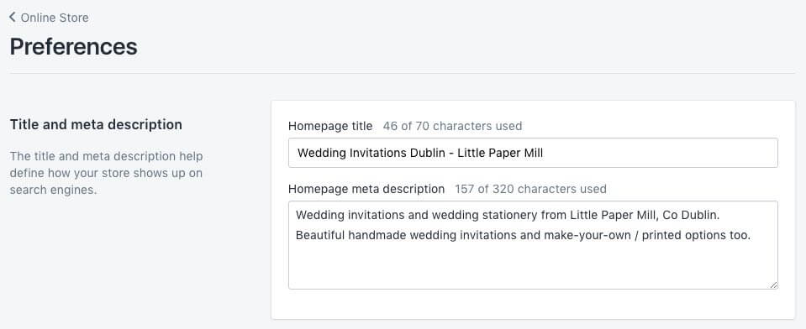
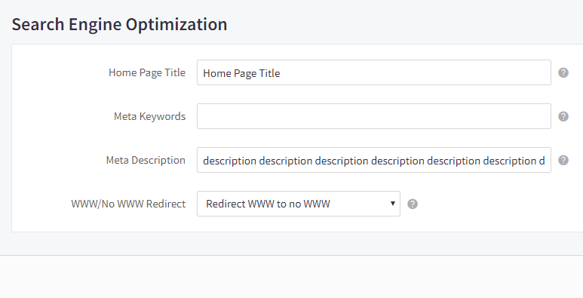
03. Shopify SEO vs BigCommerce SEO
Edit SEO option in Shopify
Edit SEO option in BigCommerce
III

Slide 21

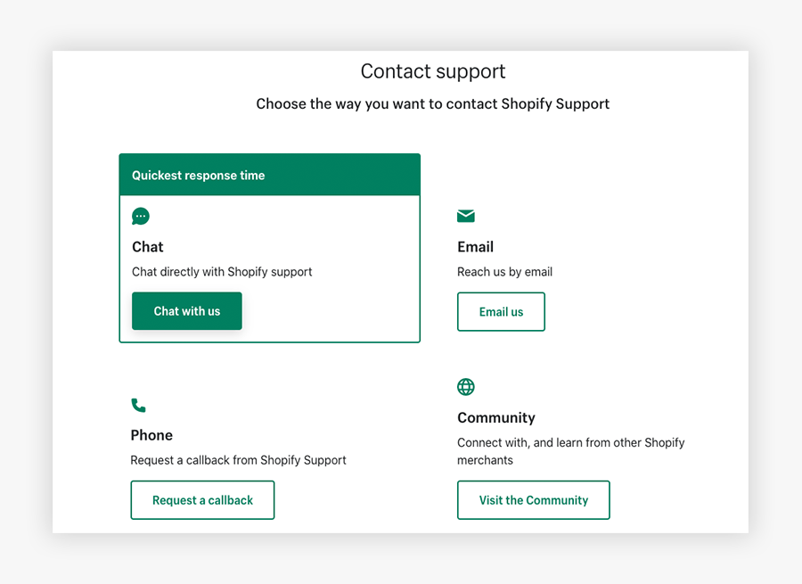
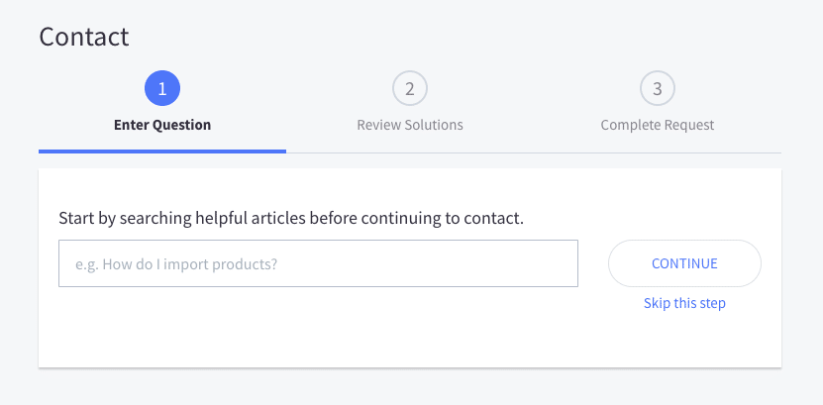
04. Support
Contacting Shopify
Contacting BigCommerce
III

Slide 22

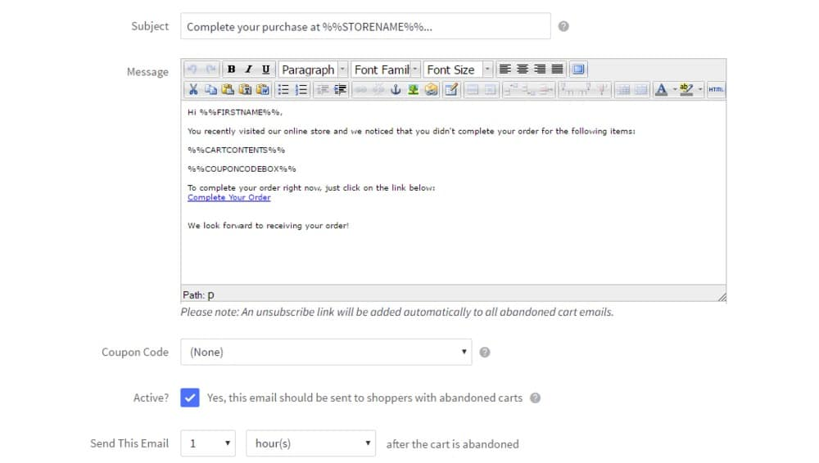
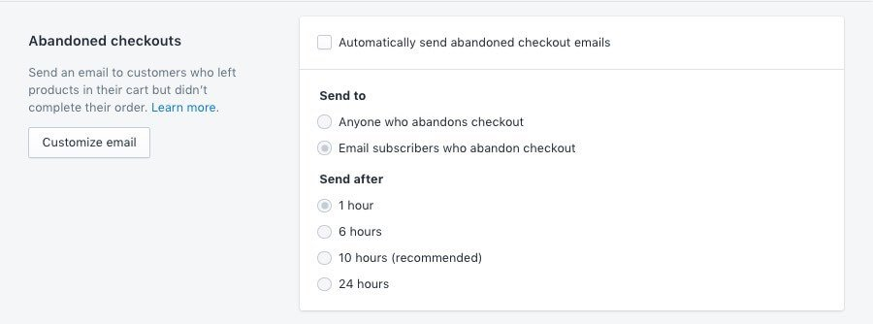
04. Abandoned cart recovery
Contacting Shopify
Contacting BigCommerce
III

Slide 23

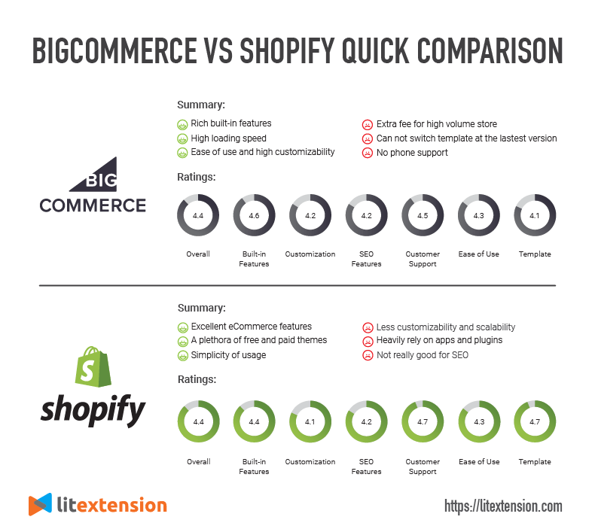
05. Conclusion
III

Slide 24
Fin
Thank you for listening

